Slide 1

Data Analytics Predicting electricity prices
Marcin Pilarski
Mateusz Saternus

Slide 2
Problem formulation
The energy market plays a crucial role in the economic development and sustainability of nations worldwide. The energy market in Poland faces multifaceted challenges, including fluctuating energy prices, increasing demand, changing regulatory frameworks, and the need to transition towards a more sustainable energy mix. These complexities pose significant difficulties for market participants, policymakers, and investors in making informed decisions regarding energy production, distribution, and consumption. To tackle these challenges effectively, it is crucial to understand the underlying patterns and interdependencies within the market, which can be achieved through statistical modelling.

Slide 3
Problem formulation – potencial use cases
The statistical modelling of the energy market in Poland offers a wide range of potential use cases across different sectors. For energy companies, the model can assist in optimizing production levels, pricing strategies, and investment decisions by providing insights into demand patterns and market conditions. Regulators and policymakers can leverage the model to evaluate the effectiveness of existing policies, design new regulations, and identify areas for promoting renewable energy sources and energy efficiency. Investors can use the model to assess the financial viability and risks associated with energy projects, aiding in informed decision-making.

Slide 4
Problem formulation – data sources
Data used in model comes from official databases. First database used in project is PVgis, which is tool released by European Commission. (https://re.jrc.ec.europa.eu/pvg_tools/en/) It helps to plan investments in solar and wind energy sources. The data contains irradiance, wind speed, temperature.
The information about energy market such as energy prices and system load come from polish energy system operator (PSE). (https://www.pse.pl/obszary-dzialalnosci/rynek-energii/ceny-i-ilosc-energii-na-rynku-bilansujacym; https://www.pse.pl/dane-systemowe/funkcjonowanie-kse/raporty-dobowe-z-pracy-kse/wielkosci-podstawowe)

Slide 5
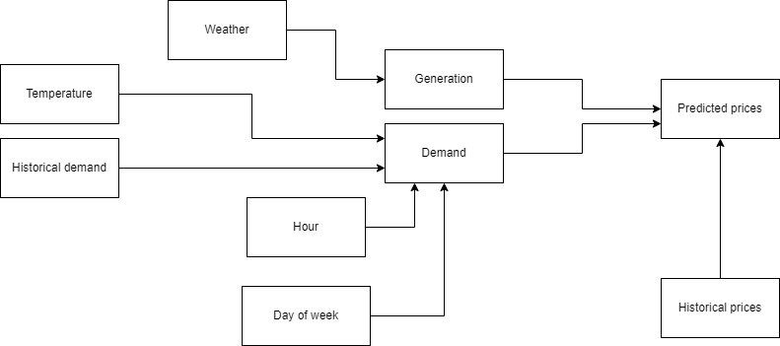
Problem formulation- Directed Acyclic Grap

Slide 6
Problem formulation - confoundings
There are few confoundings detected in the model.
The pipe type is on relation of weather->generation->price.
There are also fork type confoundings:
Hour -> Load <- Day of week
Generation -> Price <- Historical price

Slide 7
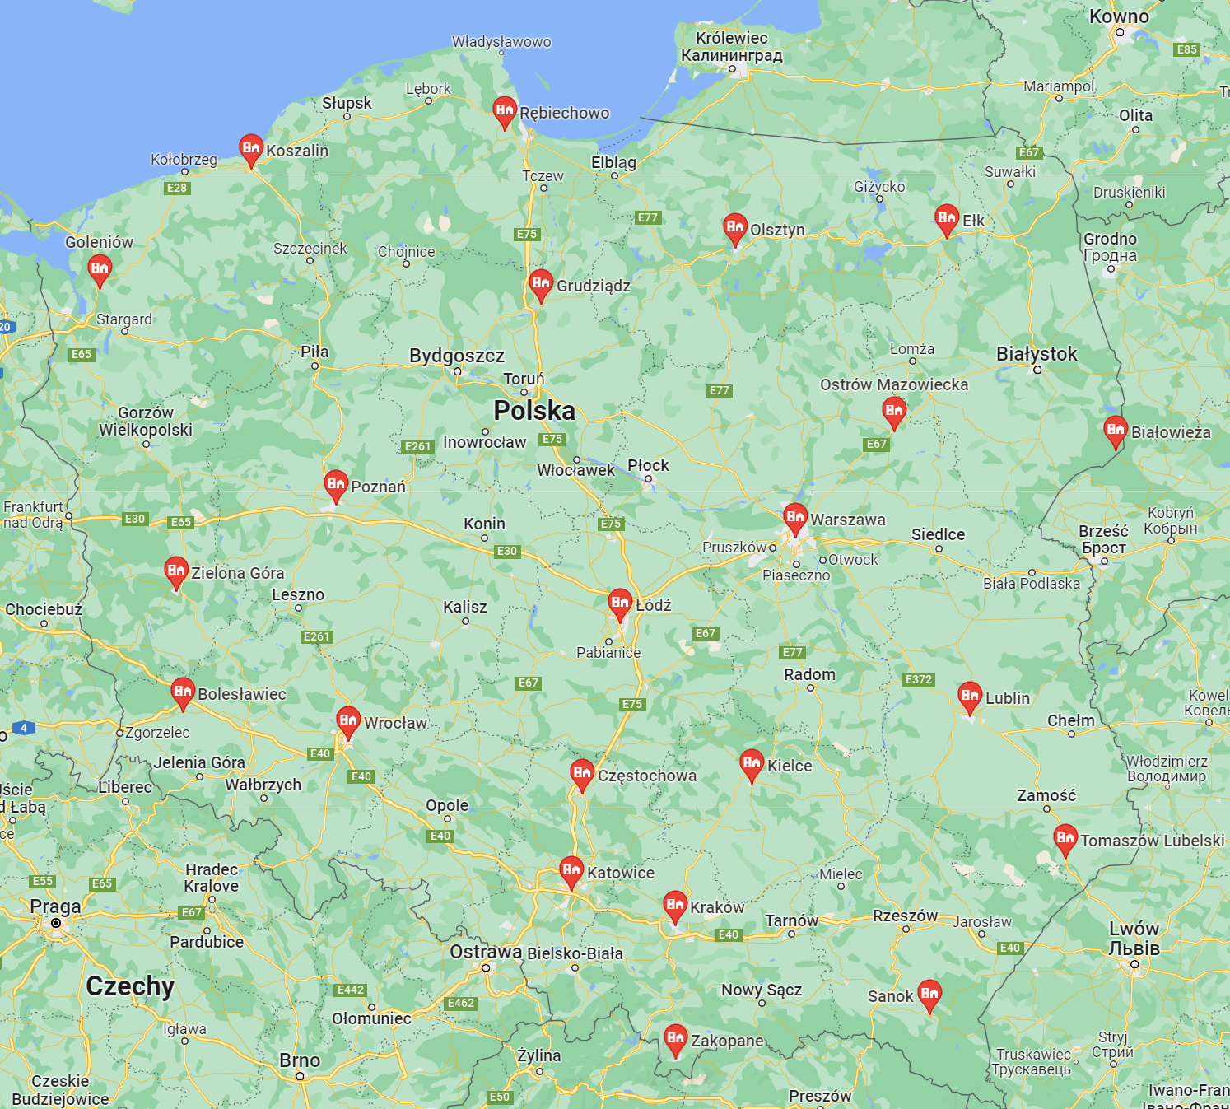
Data preprocessing
The data about the weather was downloaded from PVgis database. Although it contains all the weather values that were useful for us, it allows only to collect data locally and we need information for the whole country. Because of that we have chosen 22 points in Poland and calculated mean value at the time. Points are shown on the map. Data is collected every hour and was downloaded separately for year 2019 and 2020.
The data about the energy market was downloaded from PSE polish energy system operator. It was downloaded for march 2019 and march 2020 separately. It contained information about the system load and balancing market energy prices. The data was slightly changed to allow easier operations on dates.
Data from 2019 was used for prior and from 2020 for posterior

Slide 8
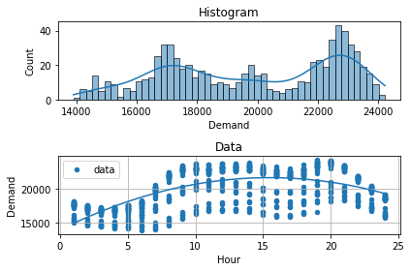
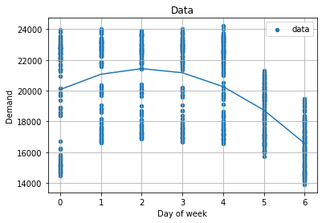
Model 1 – Demand
The load has been fitted with 2nd degree polynomial for each dependence on hour and day of week

Slide 9
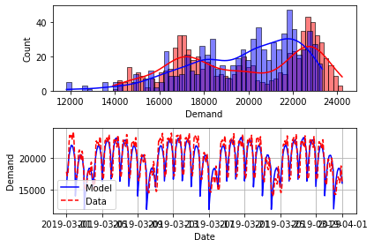
Model 1 – Demand - Prior
Fitting time data with 2nd degree polynomial allowed us to get samples with distribution shown below
Value of error was: RMSE = 1352.998 / (max possible) 19982.844

Slide 10
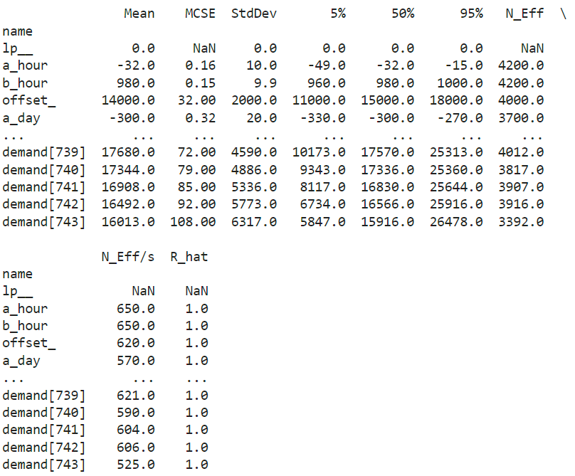
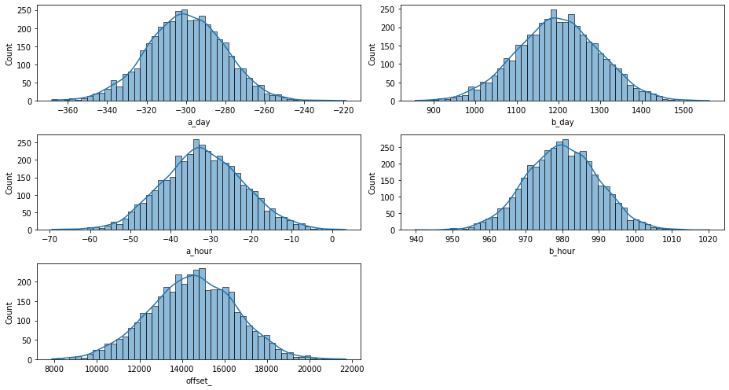
Model 1 – Demand – Prior Summary

Slide 11
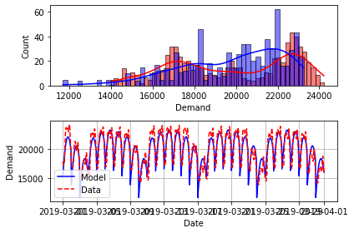
Model 1 – Demand – Posterior
Posterior modeling gave the results shown on graph
Value of error was: RMSE = 1348.9/ (max possible) 19982.8

Slide 12
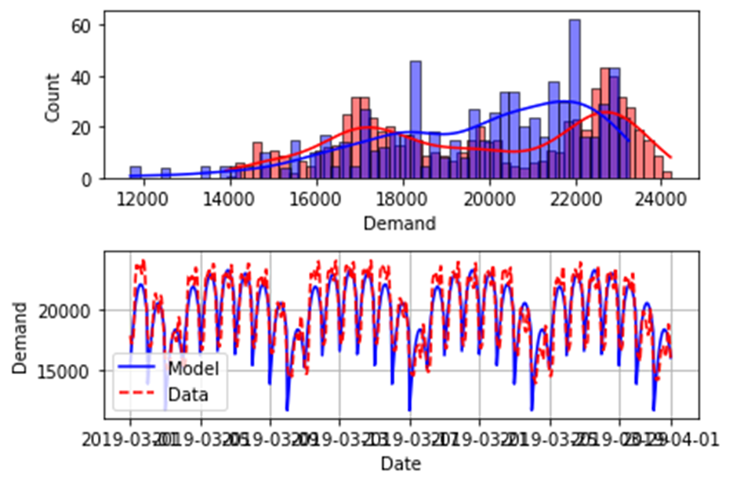
Model 1 – Demand – Posterior analysis
Posterior predictive samples are quite consistent with the data, but there are more of them in middle range (18k – 22k)
Also few samples appears in low range (below 14k), which does not exist in real data

Slide 13
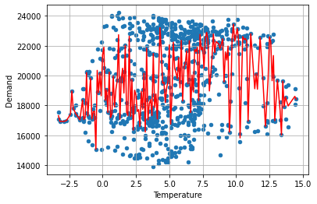
Temperature’s influence on the load
It seems that there is no influence of temperature on the demand, contrary to the project's assumptions.
Therefore, the influence of temperature was omitted in models

Slide 14
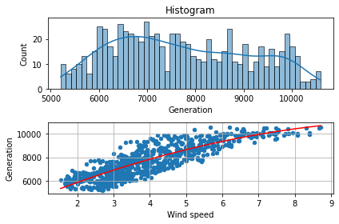
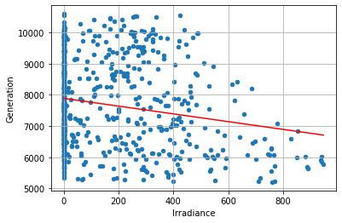
Model 1 - Generation
Generation dependence on wind and solar irradiance has been tested
As shown below, there is strong dependence on wind speed and almost no dependance on irradiation
Wind speed has been fitted with quadratic function and irradiance with linear
Therefore we omitted irradiation influence on generation in 1st model – it is added in the 2nd

Slide 15
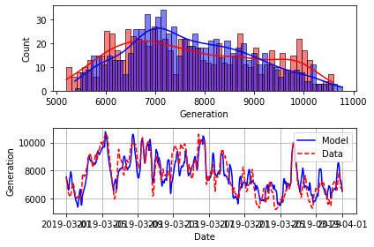
Model 1 – Generation - Prior
The prior distribution for Generation in 1st model is shown below
The value of error was: RMSE = 694.38 / (max possible) 7836.45

Slide 16
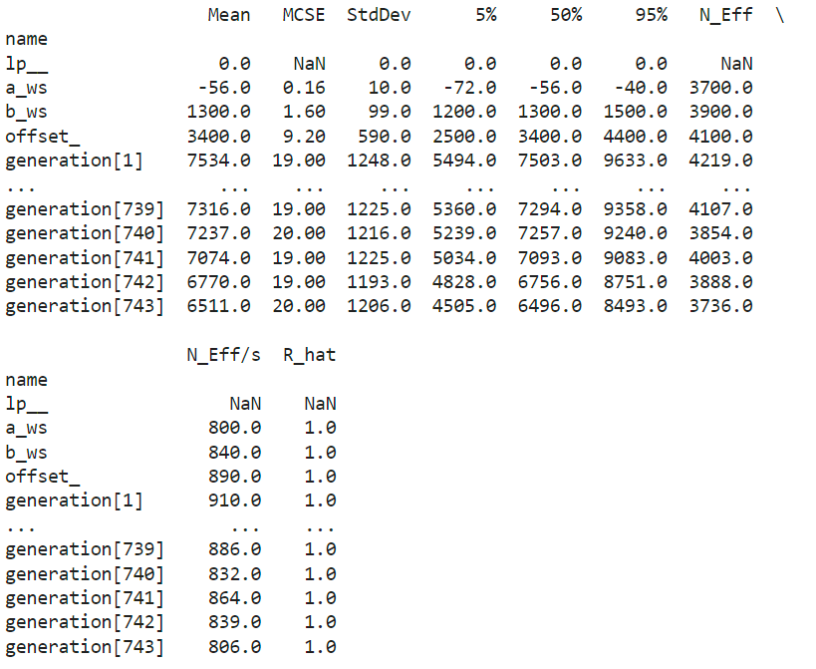
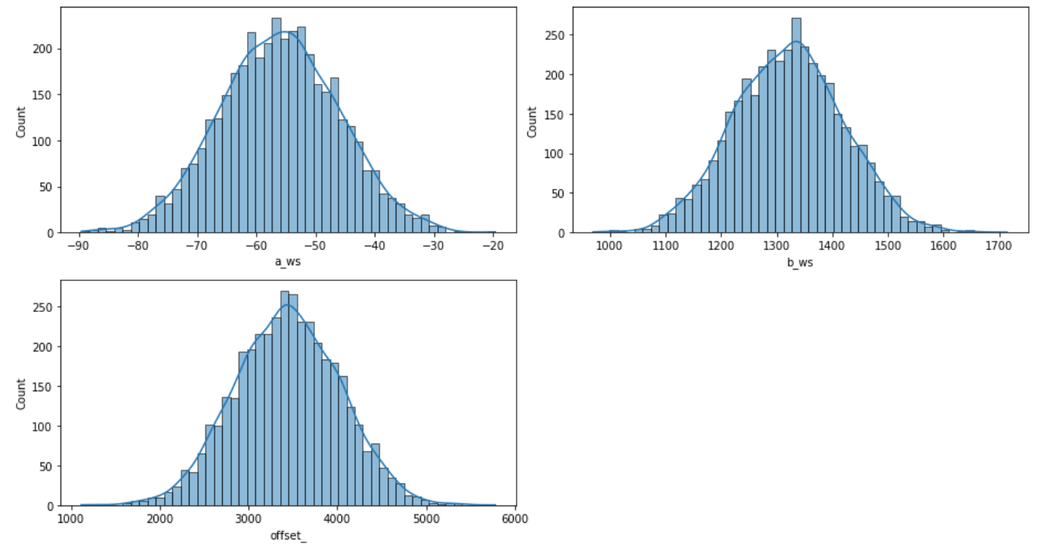
Model 1 – Generation – Prior summary

Slide 17
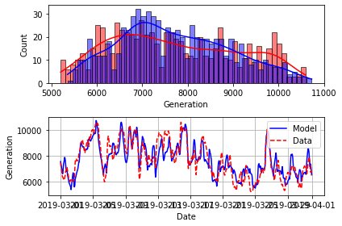
Model 1 – Generation – Posterior
Posterior modeling gave the results shown on graph
The error value was: RMSE = 694.48 / (max possible) 7836.45

Slide 18
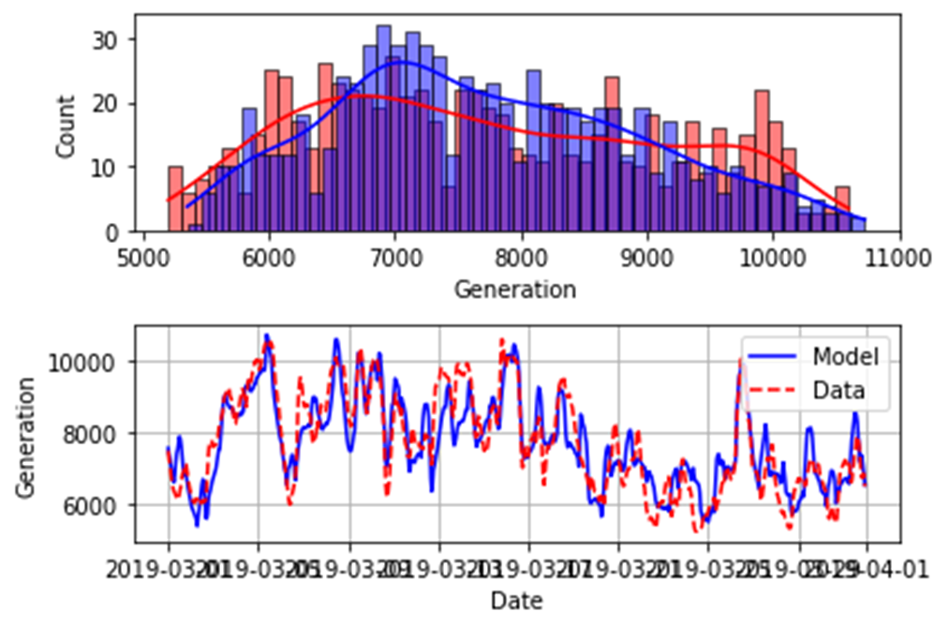
Model 1 – Generation – Posterior analysis
The posterior predictive distribution is suprisingly good consistent with the data
There are a bit more samples in middle range and fewer in distribution ends
However values of samples do not exceed range of real data

Slide 19
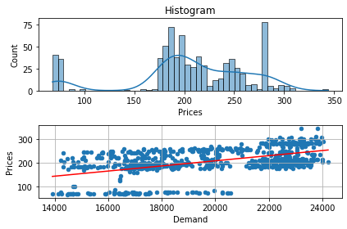
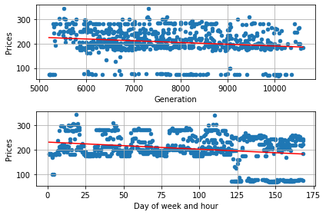
Model 1 - Prices
We have tried to determine the relations with load, generation and day of week with linear functions

Slide 20
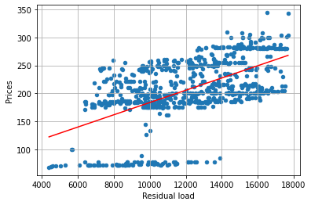
Model 1 - Prices
Finally we have decided to use the prices dependence on residulal load
Residual load is system load substracted by noncontrollable generation (called simply „Generation” in our project)
The data has been fitted with linear regression, however it is really hard to find good approximation for that data

Slide 21
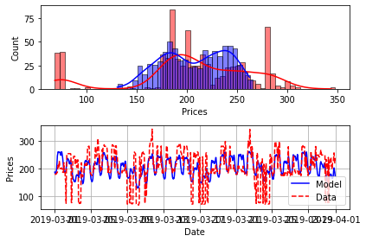
Model 1 – Prices - Prior
Modelling Prior for prices in 1st Model gave results shown below
The error value was: RMSE = 48.18 / (max possible) 214.47

Slide 22
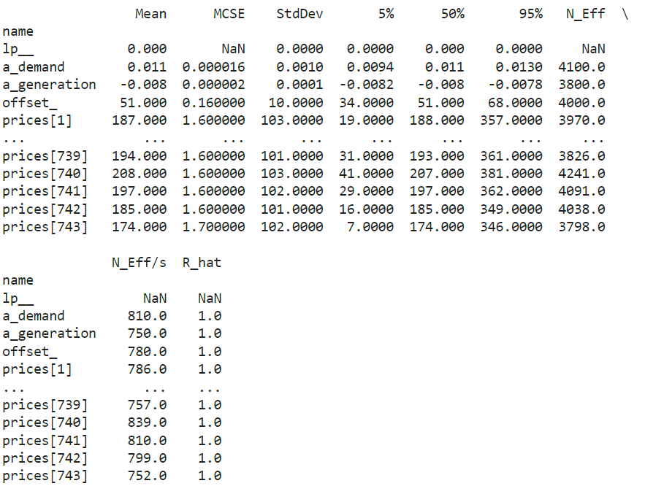
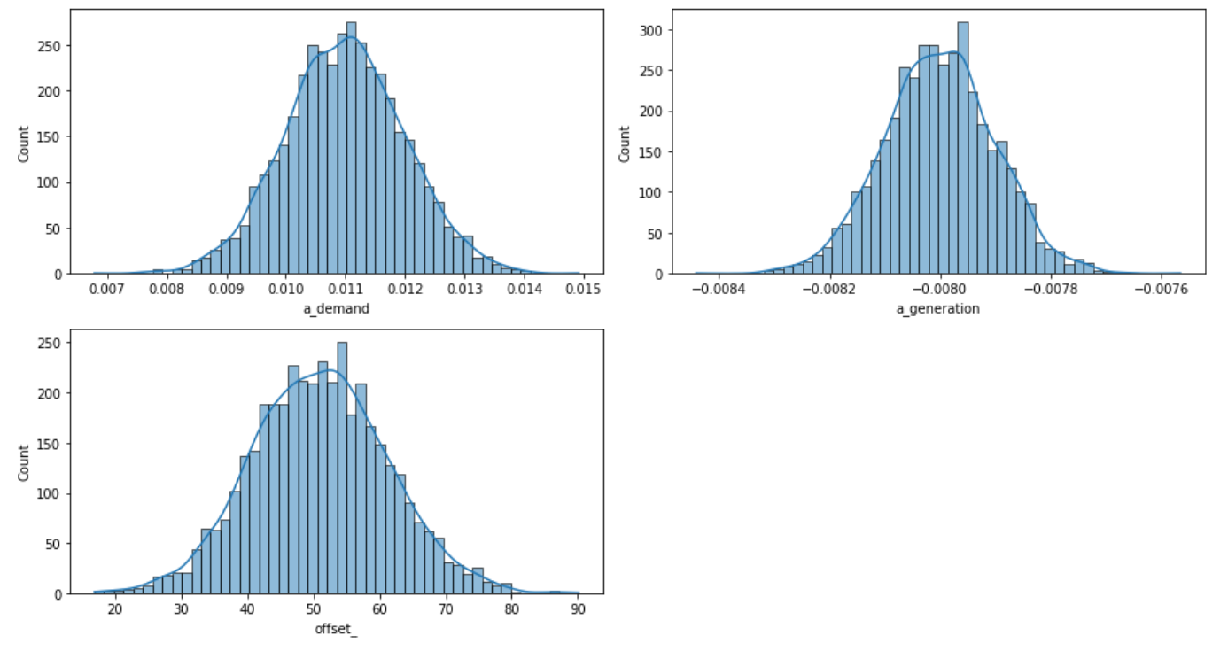
Model 1 – Prices – Prior summary

Slide 23
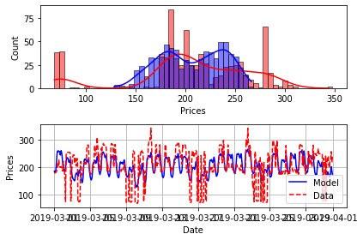
Model 1 – Prices - Posterior
Posterior model gave us results shown below
The error was: RMSE = 48.14 / (max possible) 214.47

Slide 24
Model 1 – Prices – Posterior analysis
Posterior predictive samples are quite consistient with data in middle range values, however they are not consistient with peaks in low and high values range

Slide 25
Model 1 – Prices – Posterior analysis
Energy price data is very difficult to model because of price jumps (as shown on example data on the graph below)
The jumps occur on different level of Residual load in different days

Slide 26
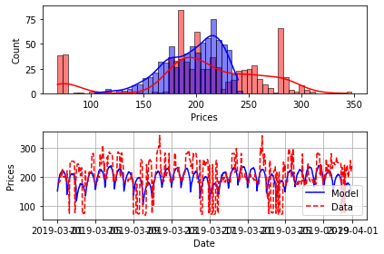
Model 1 – Overall posterior
Overall posterior results are shown below
The error value was: RMSE = 53.27 / (max possible) 214.47

Slide 27
Model 1 – Overall posteriori analysis
Overall postarior samples are somehow consistent with real data in middle values range
However they do not cover spikes on extreme values
Posterior samples values reach maximum of about 240, while real data reach up to 350

Slide 28
Model 2
Demand prior and posterior for both models are the same
2nd model differs from the first one in generation – in the 2nd one the irradiance influence is calculated, while in the first it is omitted

Slide 29
Model 2 - Generation
Generation dependence on wind is the same as in the first model
Wind speed has been fitted with quadratic function and irradiance with linear
The irreadiance influence on generation is negative, which is a bit couterintuitive
The reason for that can be explained with the fact that not only renewable Energy sources are included in non-controllable energy generation data, but also small conventional power plants

Slide 30
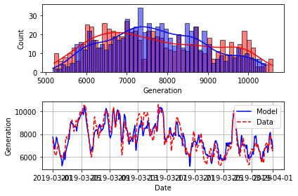
Model 2 – Generation - Prior
Modelling prior in 2nd model (with irradiance) gave results shown on graph below
The error value was: RMSE = 579.21 / (max possible) 7836.45

Slide 31
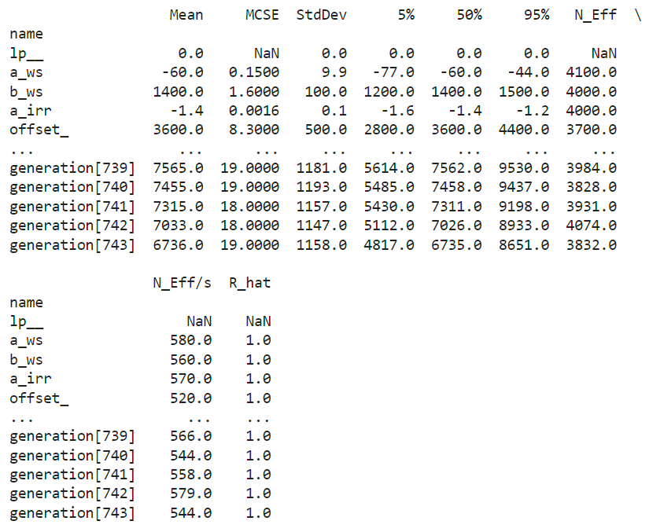
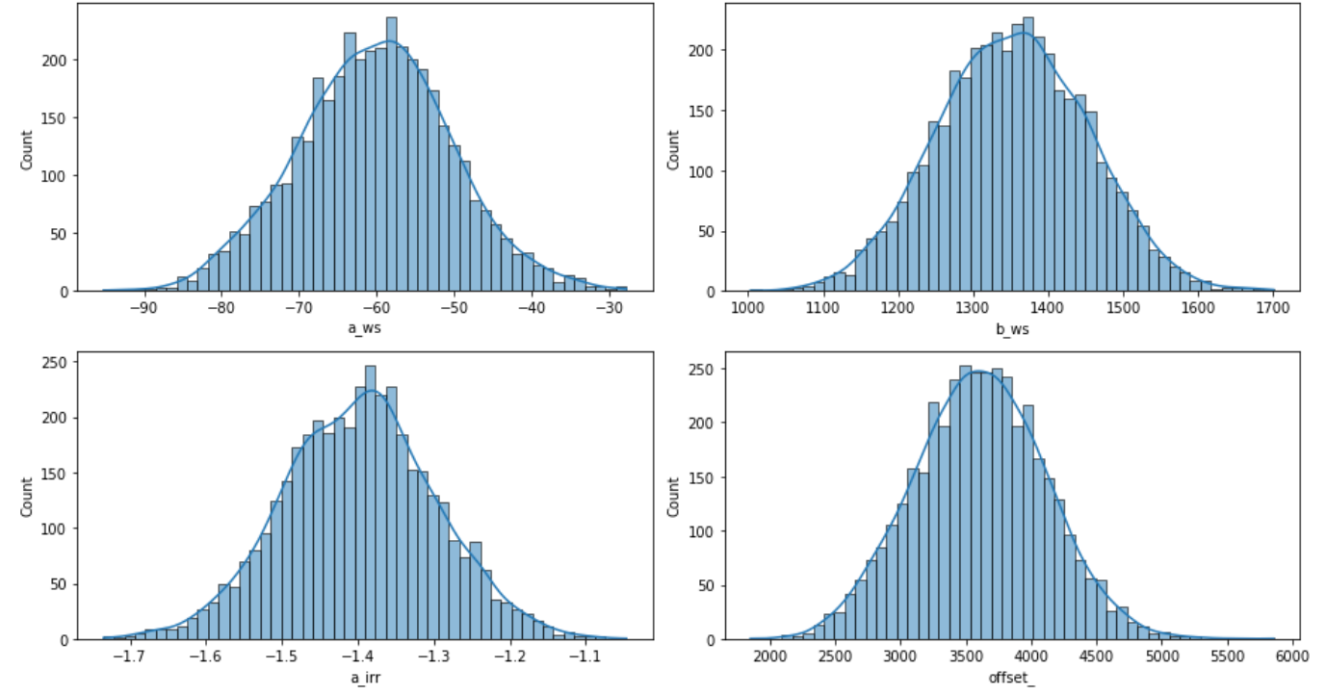
Model 2 – Generation – Prior summary

Slide 32
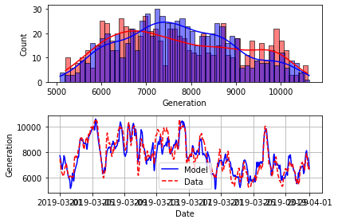
Model 2 – Generation - Posterior
Simulating posteriori gave results shown below
The error value is: RMSE = 569.56 / (max possible) 7836.45

Slide 33
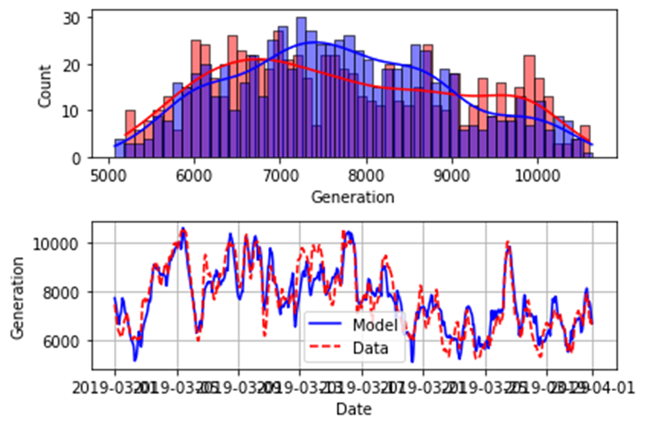
Model 2 – Generation – Posterior analysis
Posterior predictive samples are consistent with real data
There are a bit more samples in middle range of generation values

Slide 34
Model 2 - Prices
Same as for the 1st model we have tried to determine the relations with load, generation and day of week with linear functions

Slide 35
Model 2 - Prices
Same as for the 1st model dependence on Residual Load have been used

Slide 36

Model 2 – Prices - Prior
Prior for the prices gave results shown below
The error value was: RMSE = 48.13 / (max possible) 214.47

Slide 37
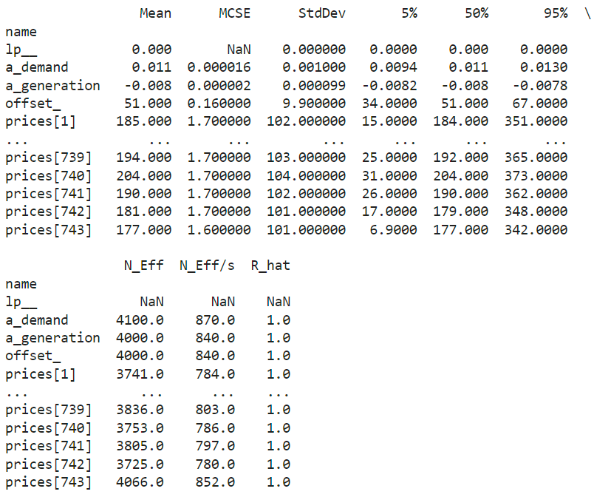
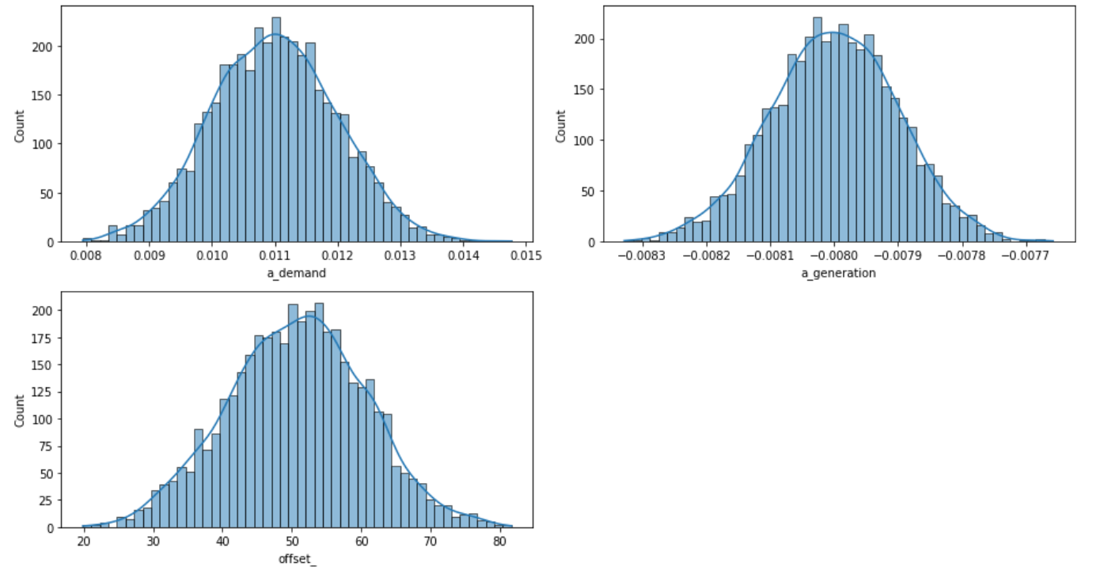
Model 2 – Prices – Prior summary

Slide 38

Model 2 – Prices – posterior
Posterior simulation for prices gave results shown below
The error value was: RMSE = 48.11 / (max possible) 214.47

Slide 39

Model 2 – Prices – posterior analysis
Same as for model 1 posterior predictive samples are quite consistient with data in middle range values, however they are not consistient with peaks in low and high values range

Slide 40

Model 2 – Overall posterior
Overall posteriori simulation for model 2 gave results shown below
The error value was: RMSE = 53.86 / (max possible) 214.47

Slide 41

Model 2 – Overall posterior analysis
Model 2 behaves really similarly to model 1
Overall postarior samples are somehow consistent with real data in middle values range
However they do not cover spikes on extreme values
Posterior samples values reach maximum of about 240, while real data reach up to 350

Slide 42
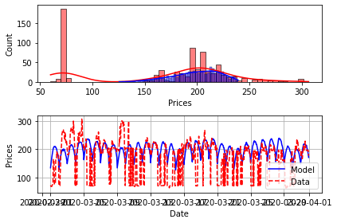
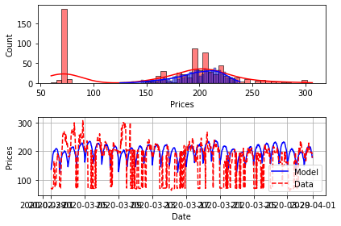
Model comparission
Predictions for 2020
Model with irradiance Model without irradiance
RMSE = 70.40 / (max possible) 180.57 RMSE = 69.84 / (max possible) 180.57
Both models give similar results, model without irradiance has a bit lower RMSE

Slide 43
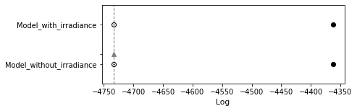
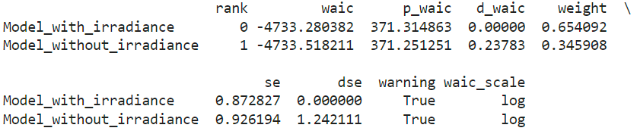
Model comparision using information criteria - waic
As shown on waic comparisson graph and statistics both models perform really simillar, which is because the only difference between tchem is taking into calculations dependence on solar irradiation which doas not have big influence on final data

Slide 44
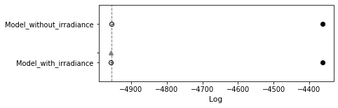
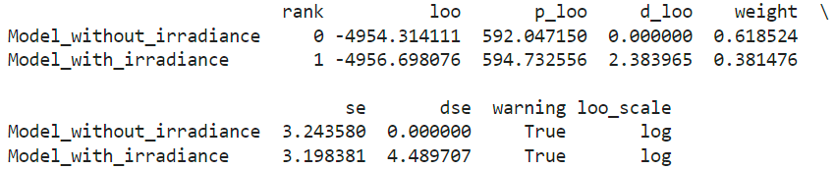
Model comparision using information criteria - loo
Same as for waic, in comparision using loo the results are also very simmilar
Besed on the information given by waic and loo criteria Model 1 and Model 2 overlap

Slide 45
Additional model
Additional model was based on fitting distributions of data with polynomial regressions
No histograms were used
Priors were based on student and normal distributions

Slide 46
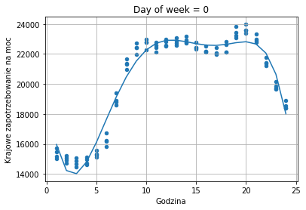
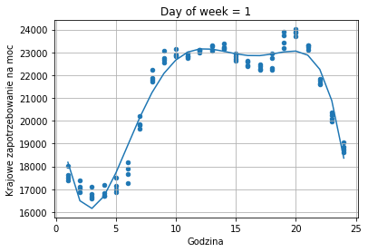
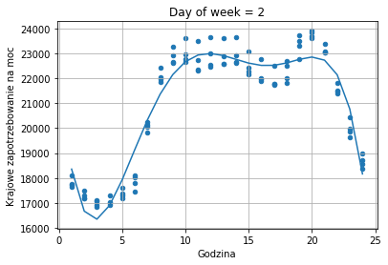

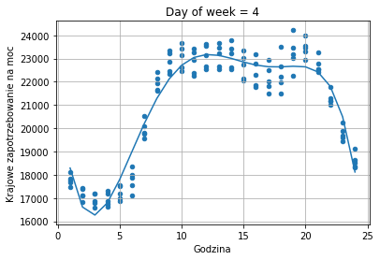
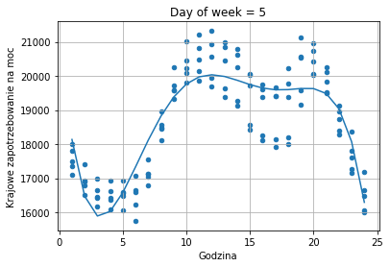
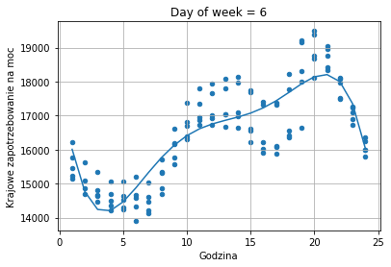
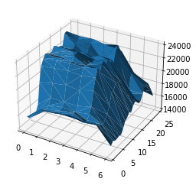
Additional model - Demand
Hourly demand distriution has been done separately for each weekday
Distributions are fitted with 5th degree polynomial

Slide 47
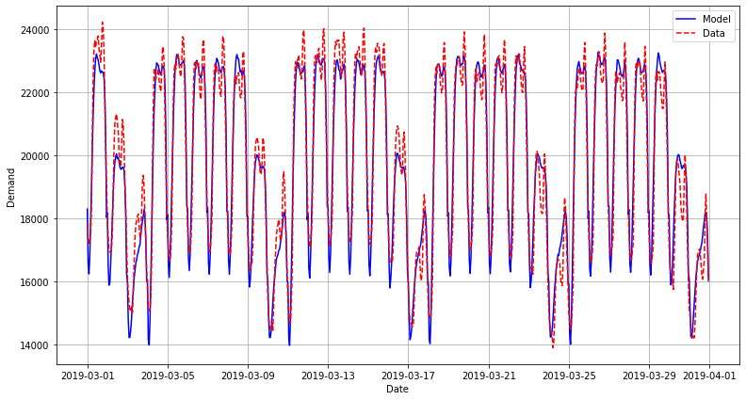
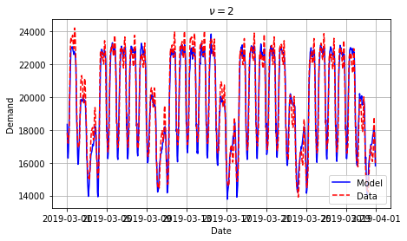
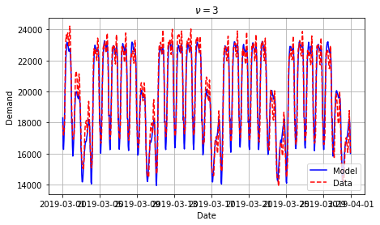




Additional model – Demand - prior
We have tested normal distribition and T-student distributions with various degrees of freedom
The best results were reached for nu=10.

Slide 48
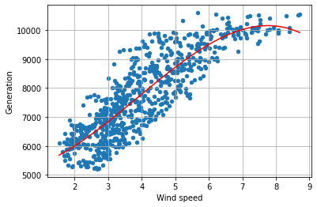
Additional model –Generation
As for the 1st model the influence of irradiation has been omitted
The wind influence was fitted with 3rd degree polynomial

Slide 49
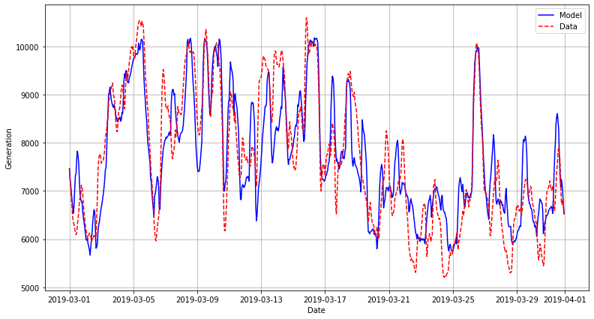






Additional model – Generation – prior
We have tested normal distribition and T-student distributions with various degrees of freedom
The best results were reached for nu=100.

Slide 50

Additional model – prices
The dependence of prices on the residual load has been fitted with 5th degree polynomial

Slide 51







Additional model – prices - prior
We have tested normal distribition and T-student distributions with various degrees of freedom
The best results were reached for nu=100.

Slide 52

Additional model – Posterior
Posterior for the additional model gaze the results shown on the graph below
The error value was: RMSE = 50.57 / (max possible) 214.47
The posterior samples are quite consistent with real data but they do not reach the extremes of real prices

